Slide 1
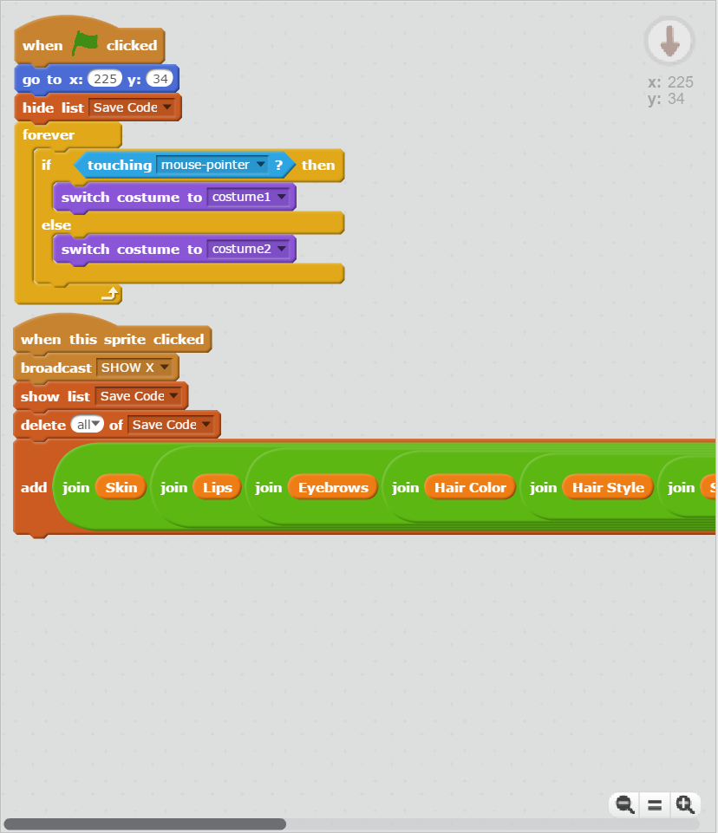

Slide 2
Short Enough
Notes:
Short Enough Full 01.png

Slide 3
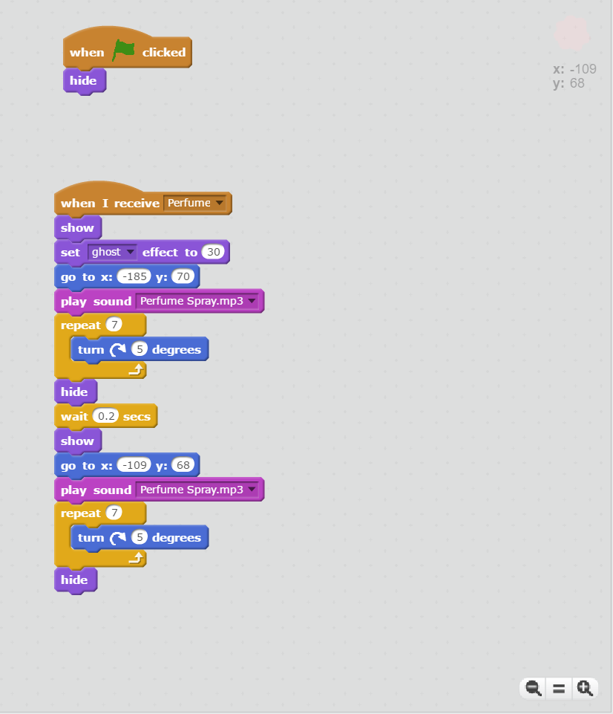

Slide 4
Too Long
Notes:
Too Long Full 01.png

Slide 5
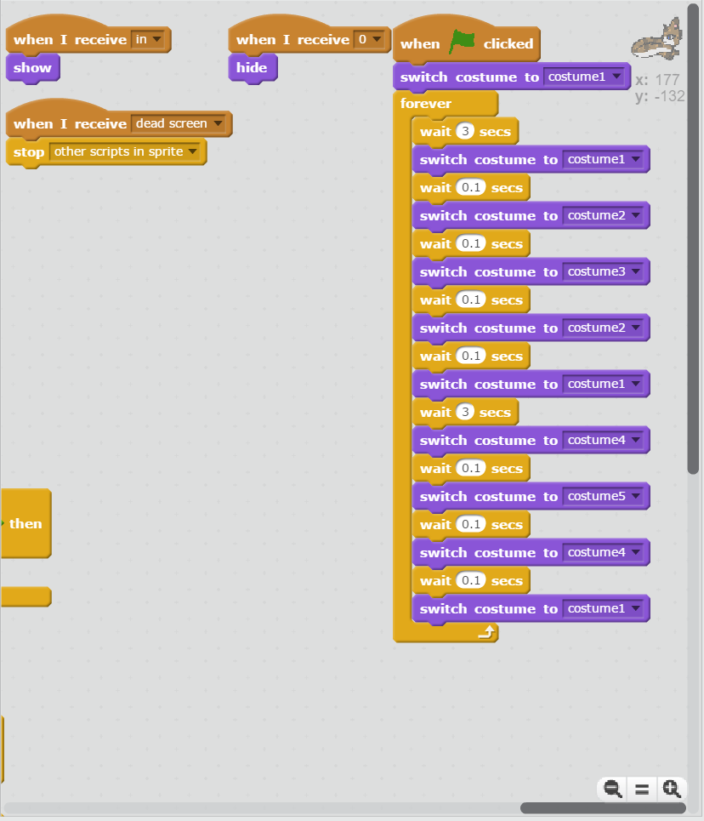

Slide 6
Too Long
Notes:
Too Long Full 09.png

Slide 7
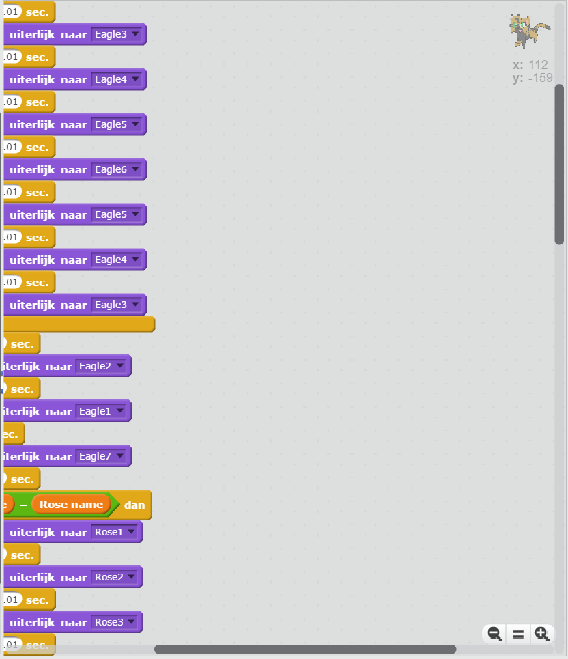

Slide 8
Too Long
Notes:
Too Long Full 31.png

Slide 9
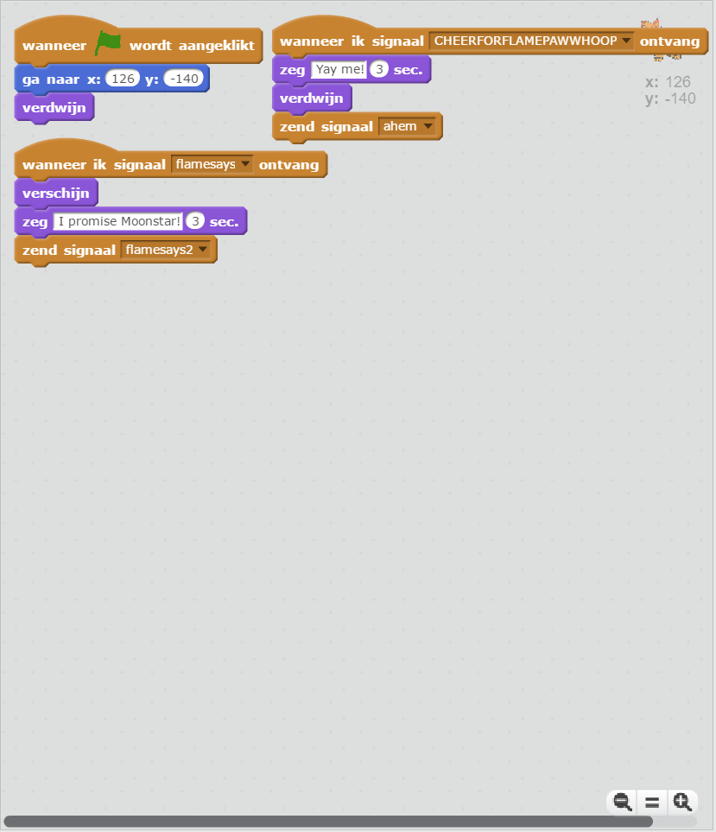

Slide 10
Short Enough
Notes:
Short Enough Full 25.png

Slide 11
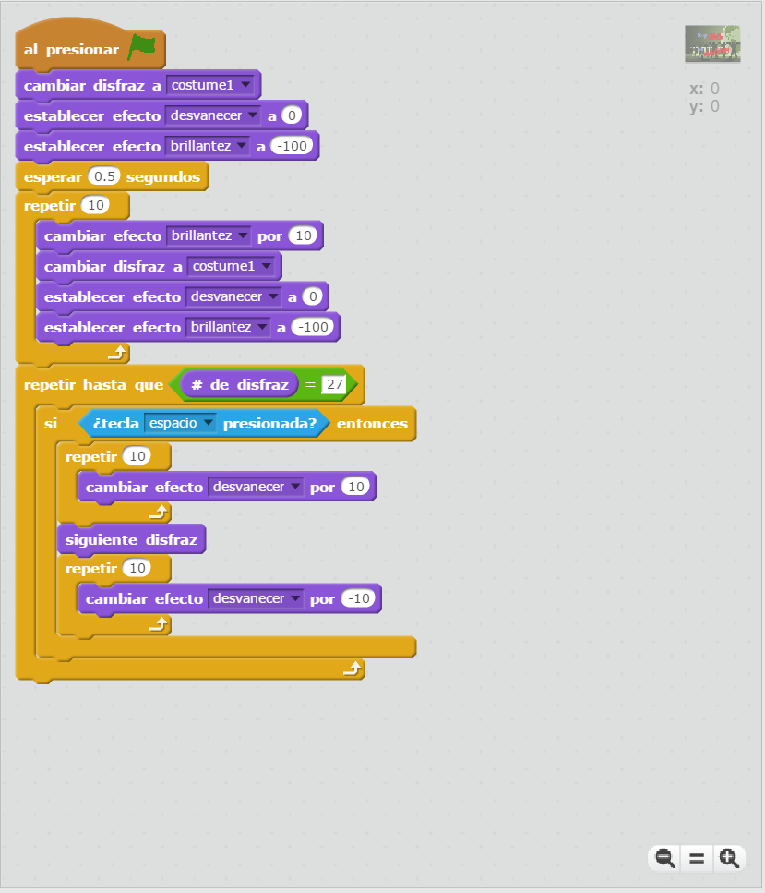

Slide 12
Too Long
Notes:
Too Long Full 27.png

Slide 13
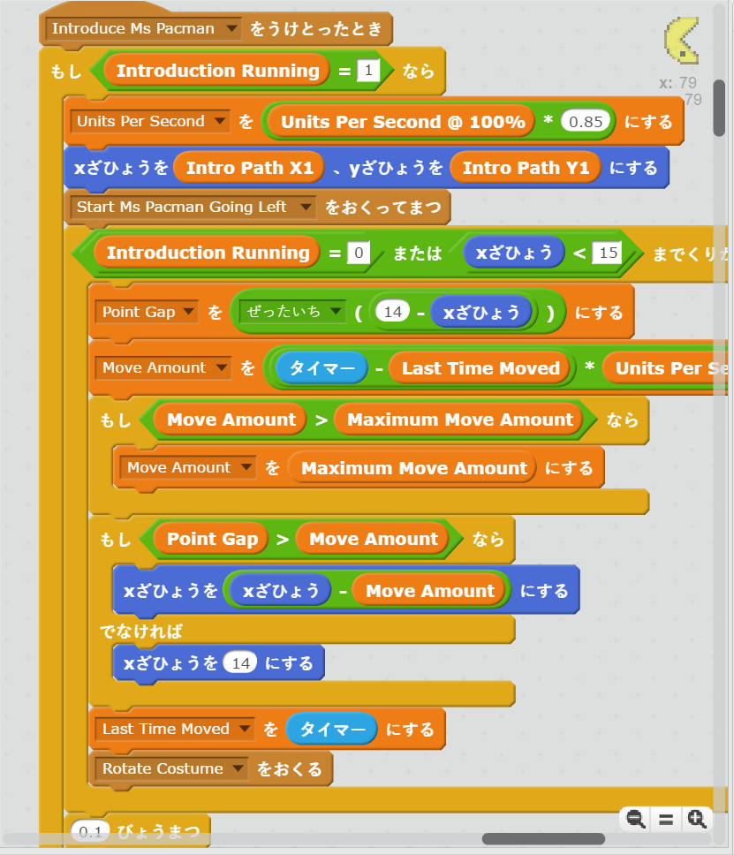

Slide 14
Too Long
Notes:
Too Long Full 19.png

Slide 15
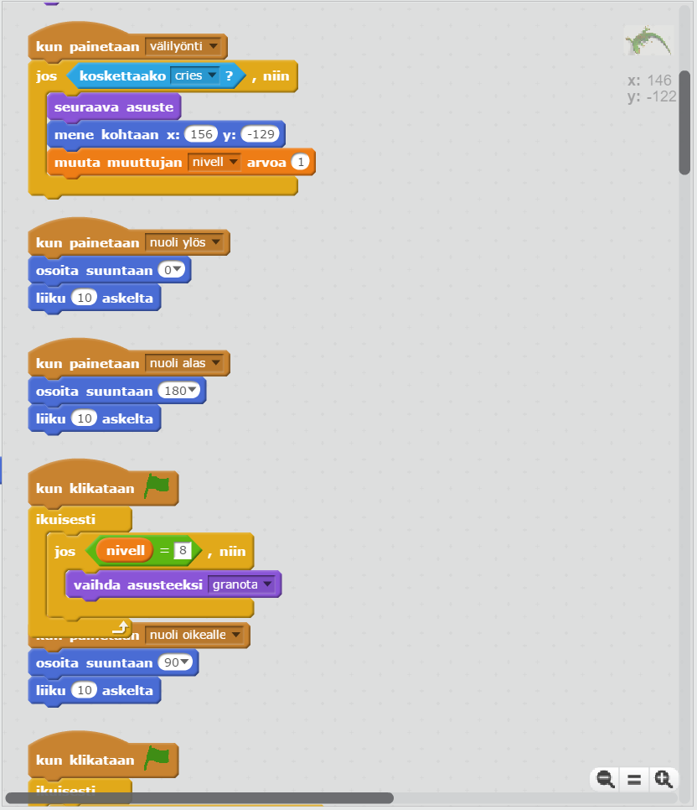

Slide 16
Short Enough
Notes:
Short Enough Full 29.png

Slide 17
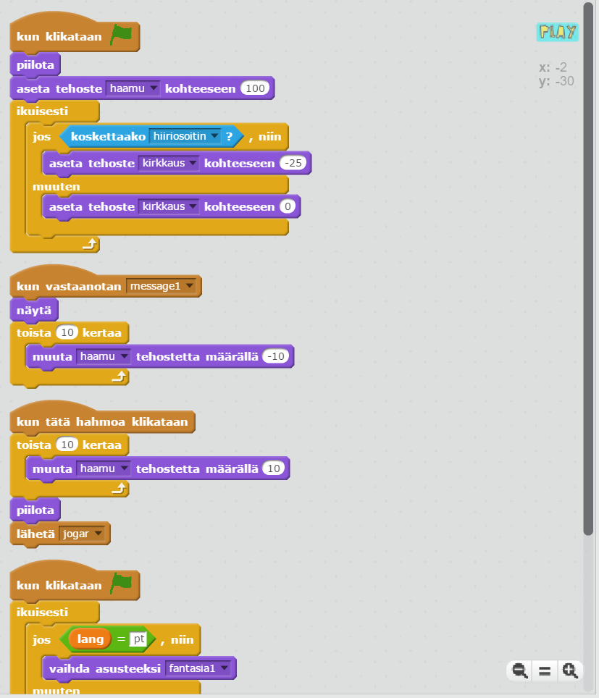

Slide 18
Short Enough
Notes:
Short Enough Full 30.png

Slide 19
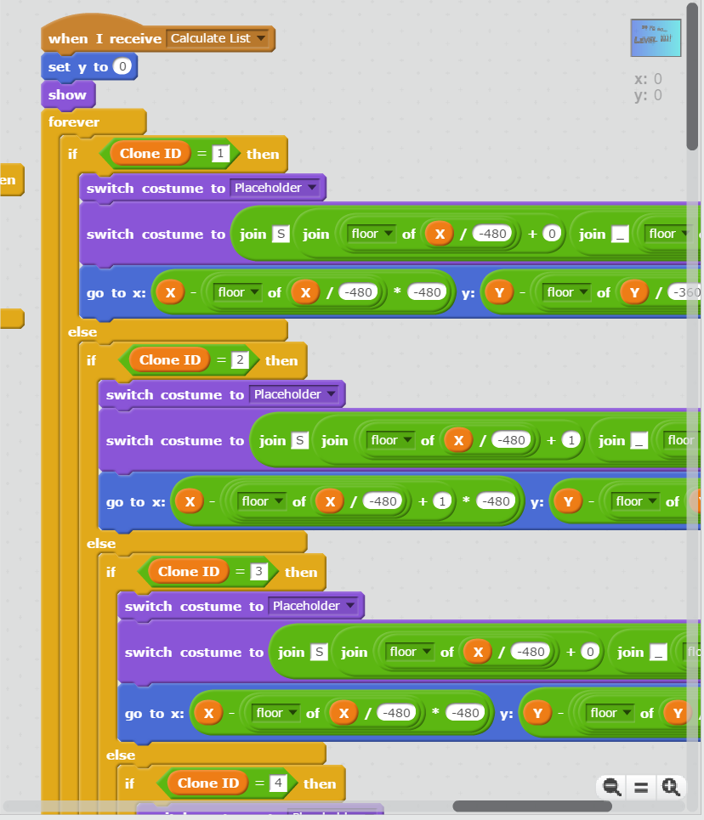

Slide 20
Short Enough
Notes:
Short Enough Full 19.png

Slide 21
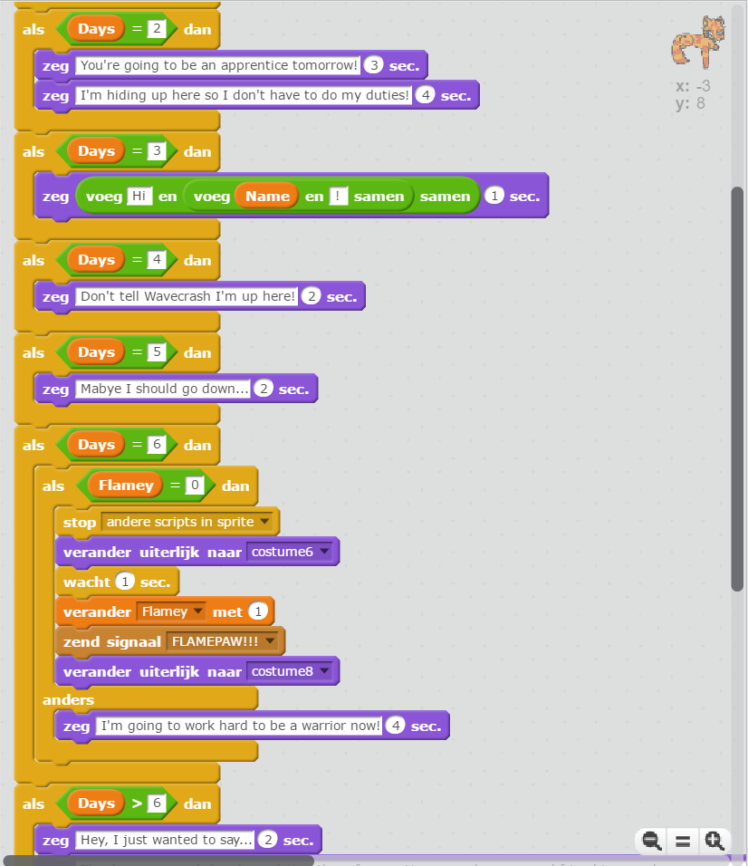

Slide 22
Too Long
Notes:
Too Long Full 12.png

Slide 23
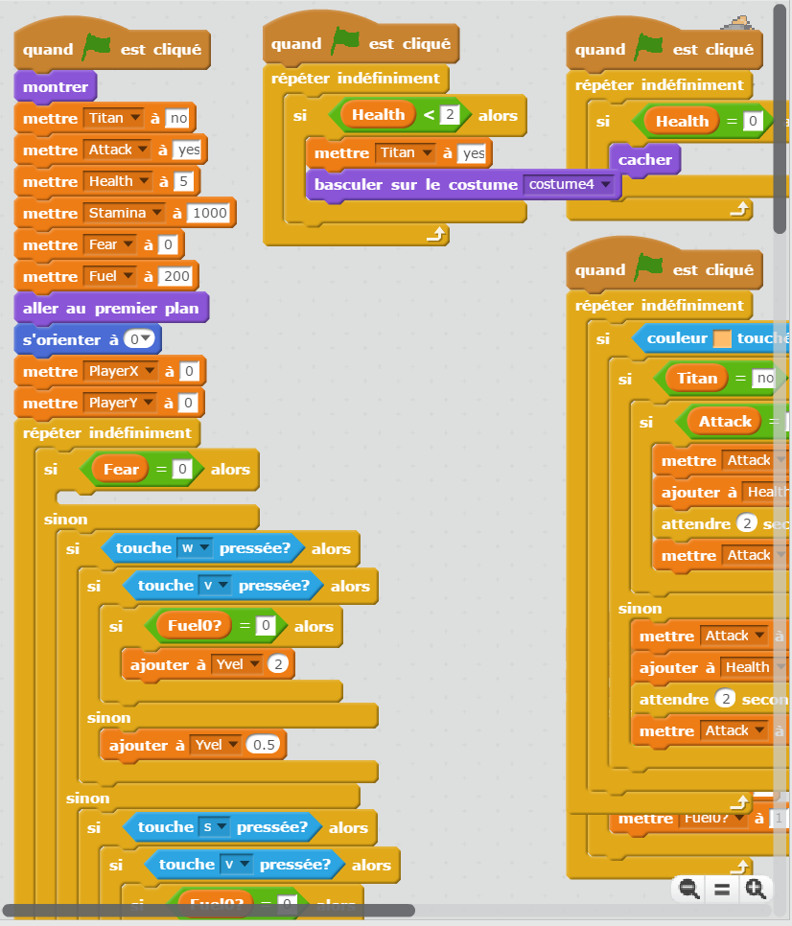

Slide 24
Too Long
Notes:
Too Long Full 18.png

Slide 25
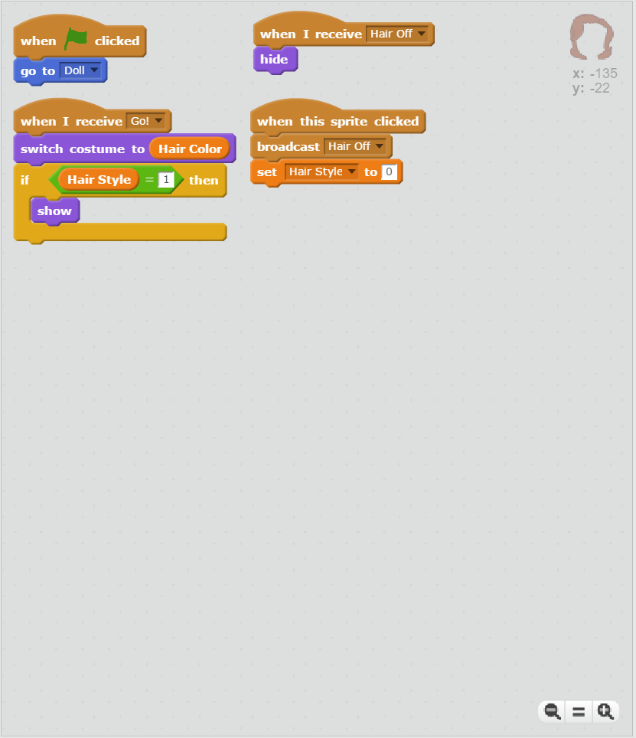

Slide 26
Short Enough
Notes:
Short Enough Full 09.png

Slide 27
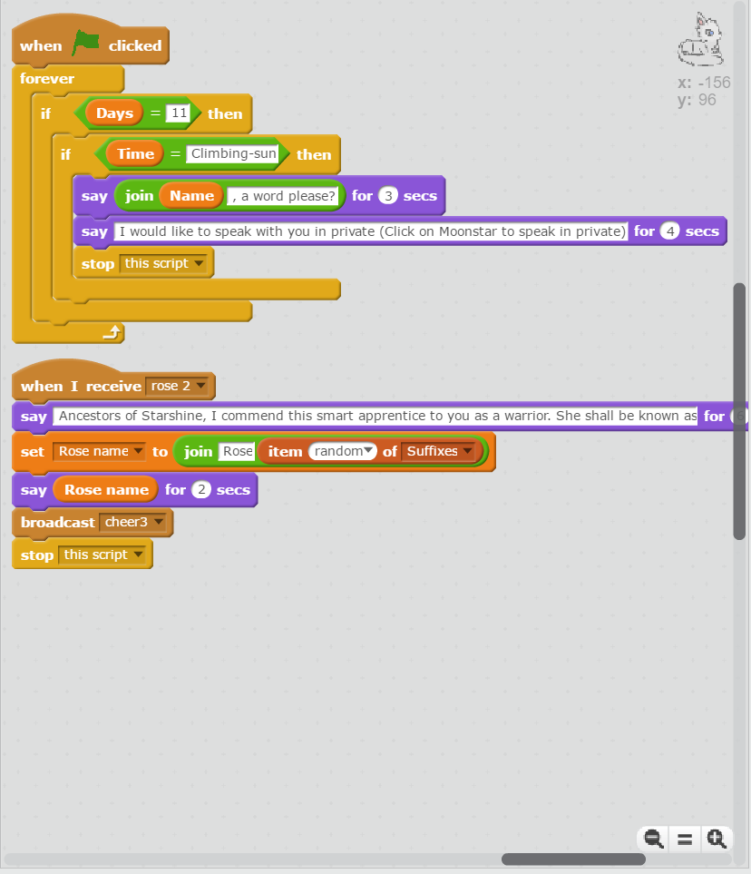

Slide 28
Short Enough
Notes:
Short Enough Full 23.png

Slide 29
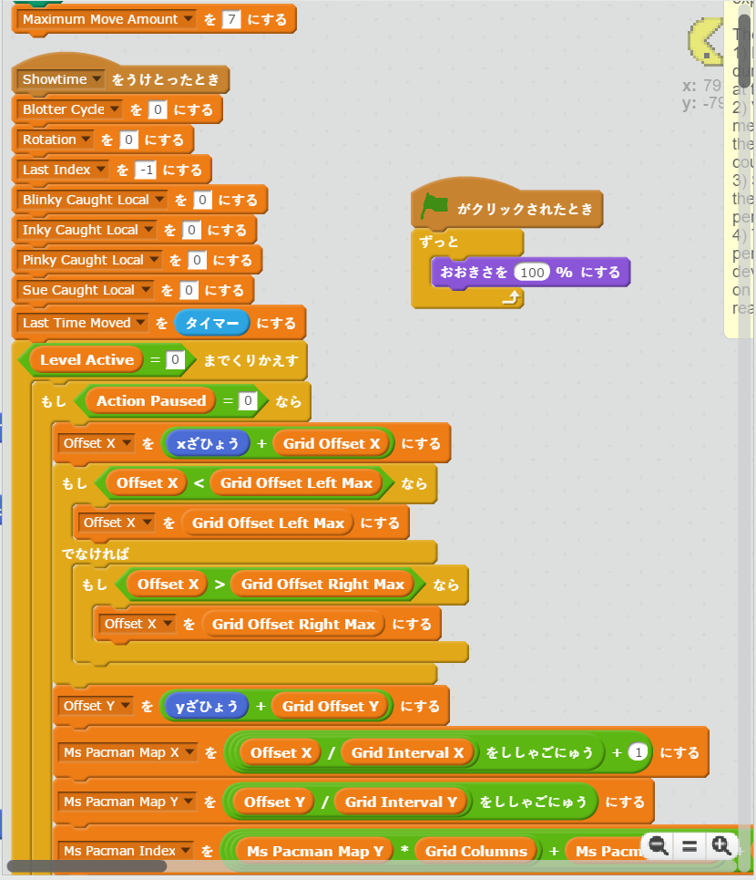

Slide 30
Too Long
Notes:
Too Long Full 29.png

Slide 31
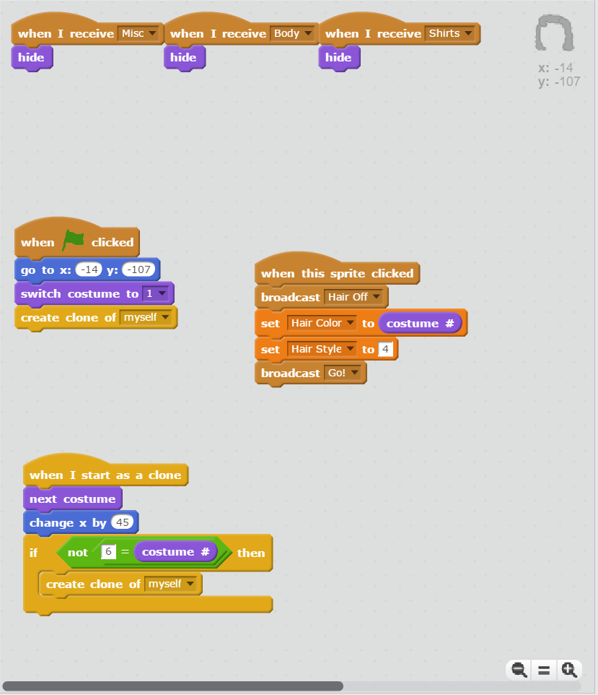

Slide 32
Short Enough
Notes:
Short Enough Full 13.png

Slide 33
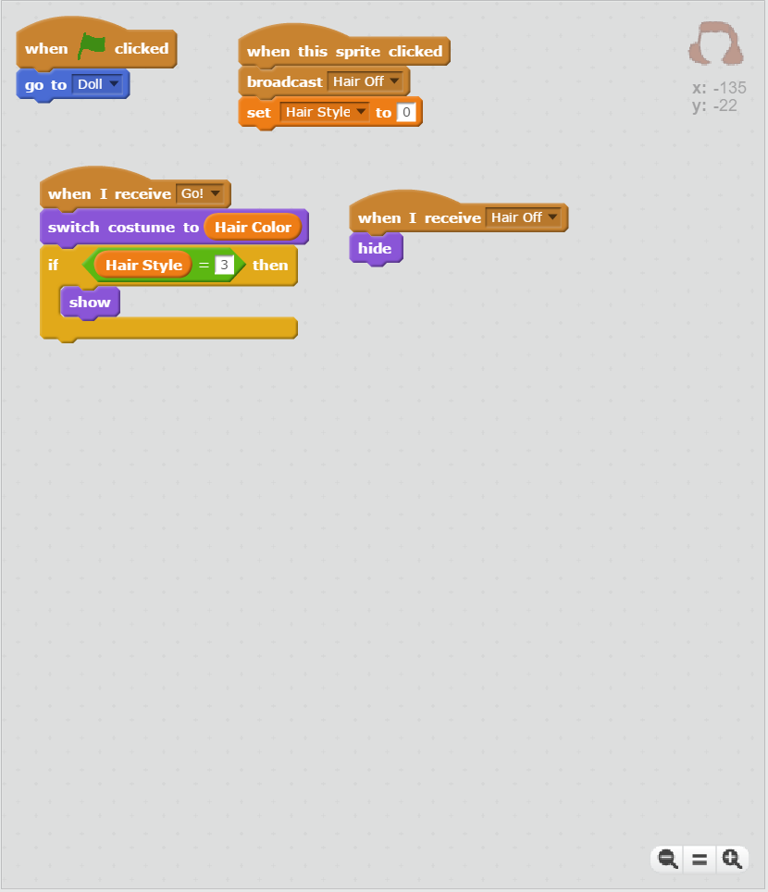

Slide 34
Short Enough
Notes:
Short Enough Full 12.png

Slide 35
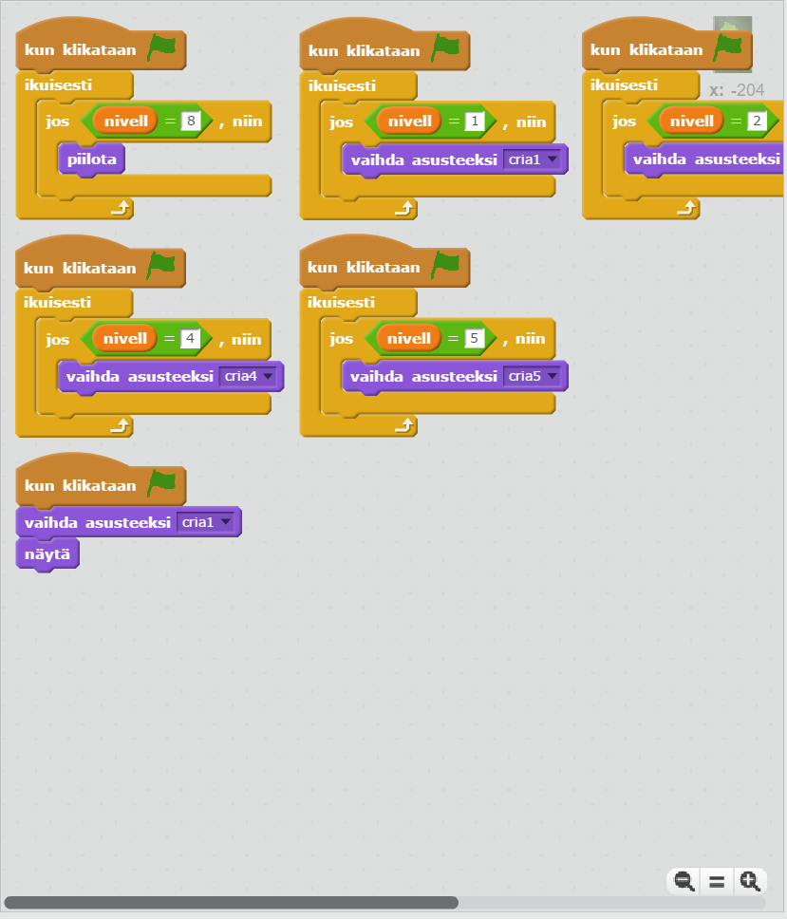

Slide 36
Short Enough
Notes:
Short Enough Full 28.png

Slide 37
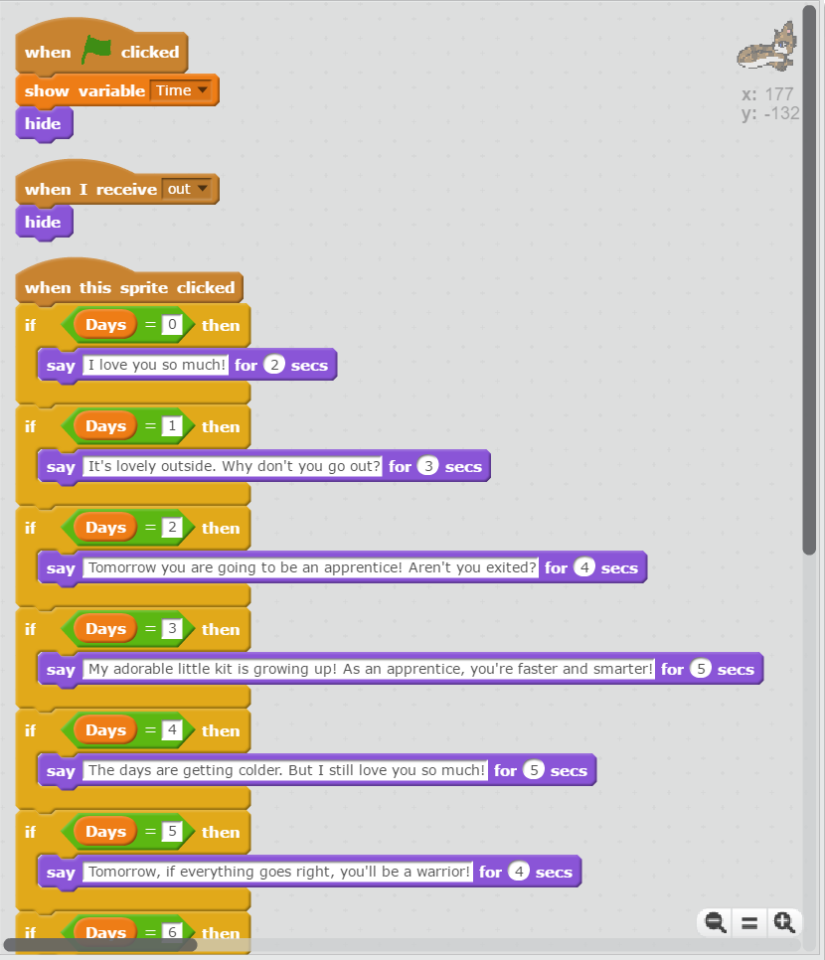

Slide 38
Too Long
Notes:
Too Long Full 07.png

Slide 39
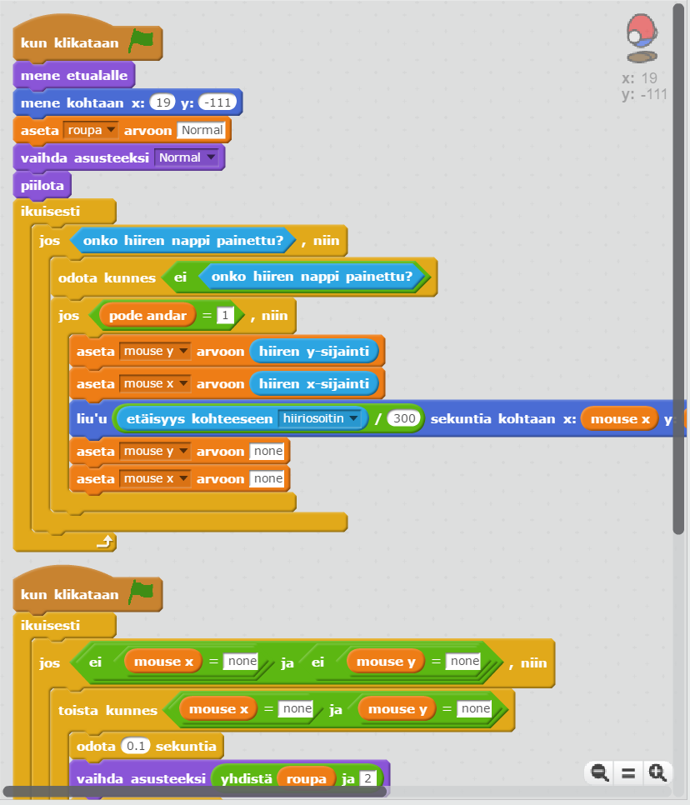

Slide 40
Too Long
Notes:
Too Long Full 28.png

Slide 41
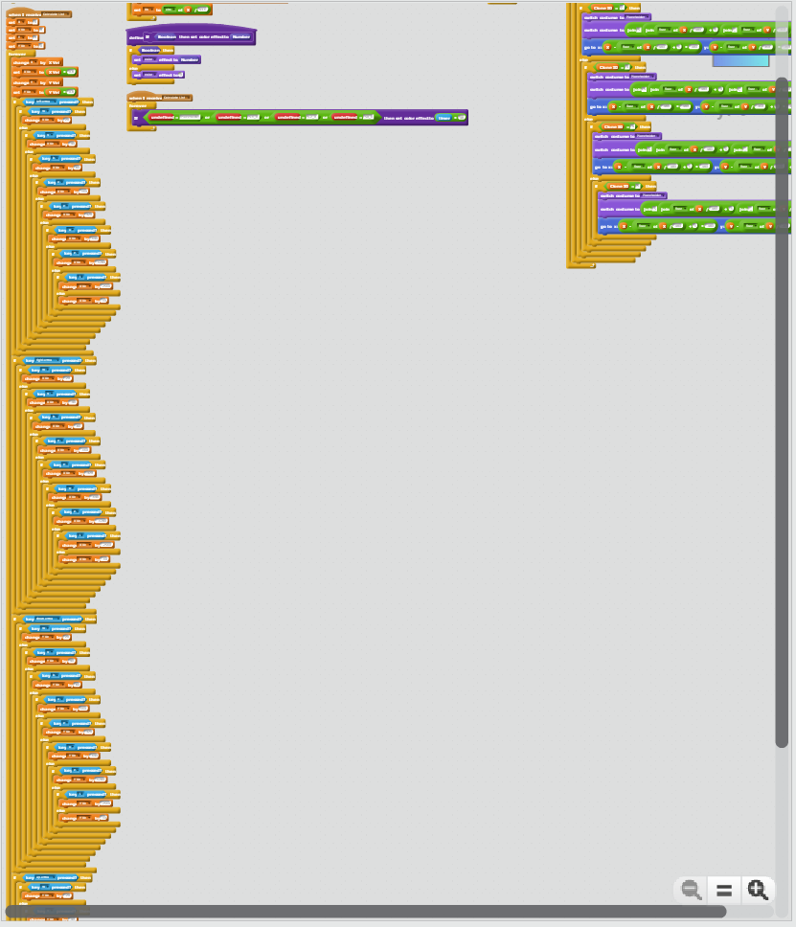

Slide 42
Too Long
Notes:
Too Long Full 14.png

Slide 43
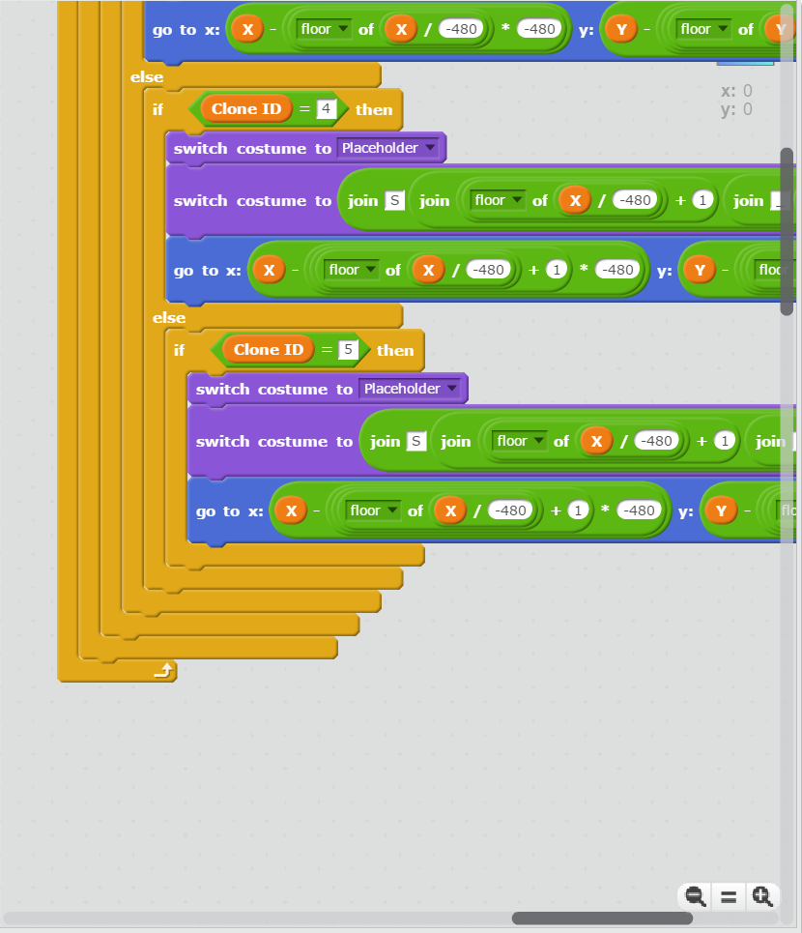

Slide 44
Too Long
Notes:
Too Long Full 03.png

Slide 45
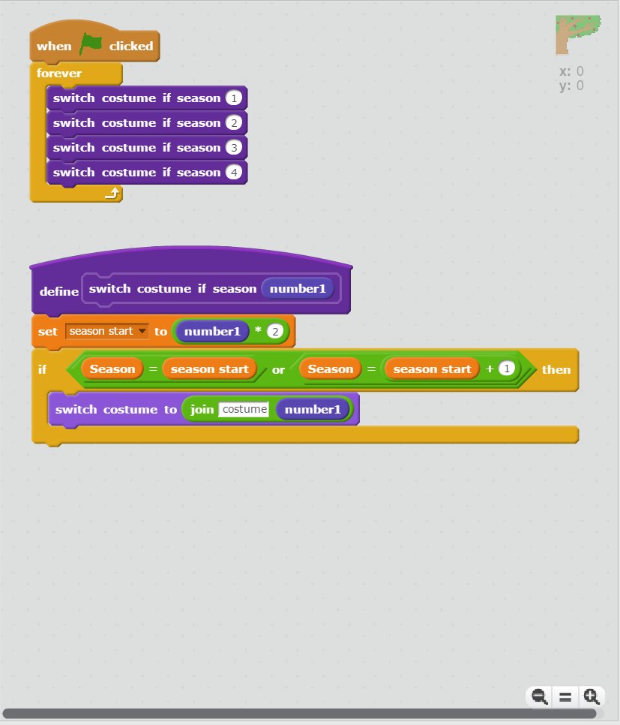

Slide 46
Short Enough
Notes:
Short Enough Full 20.png

Slide 47
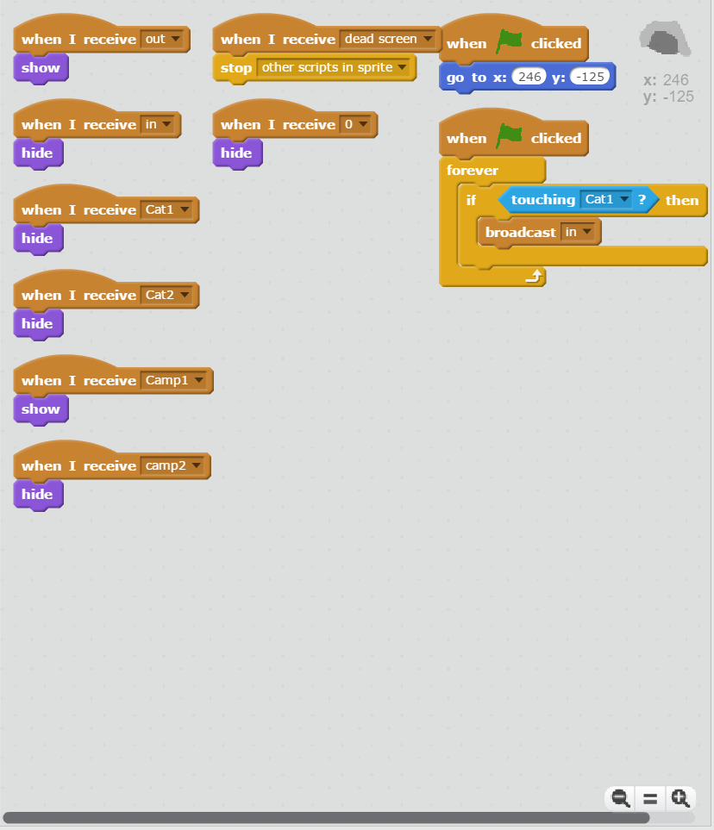

Slide 48
Short Enough
Notes:
Short Enough Full 22.png

Slide 49
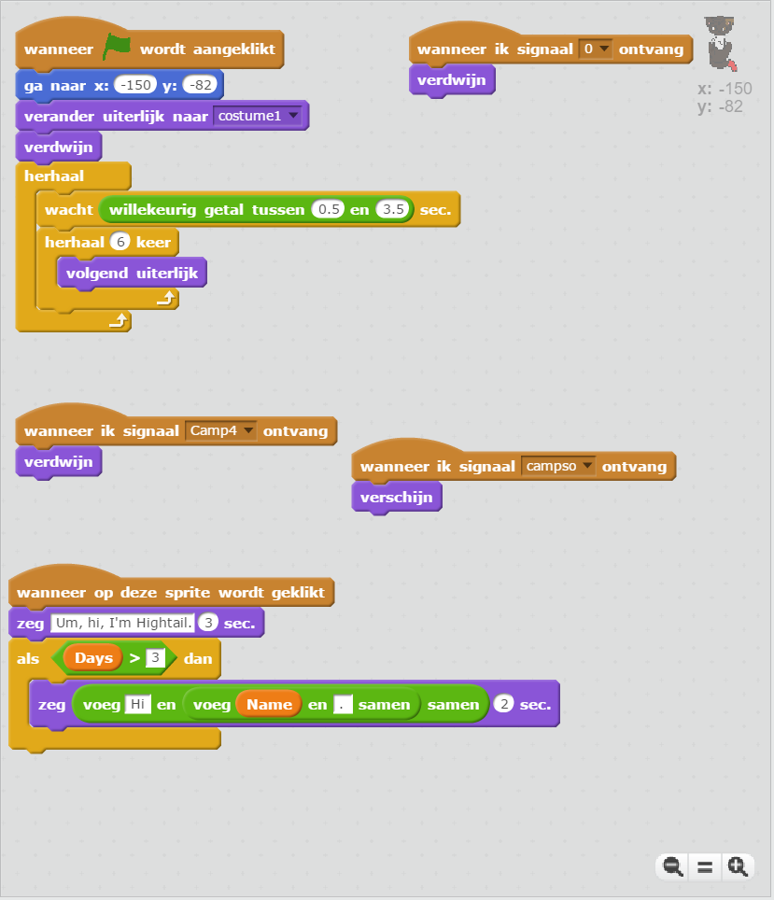

Slide 50
Short Enough
Notes:
Short Enough Full 26.png

Slide 51
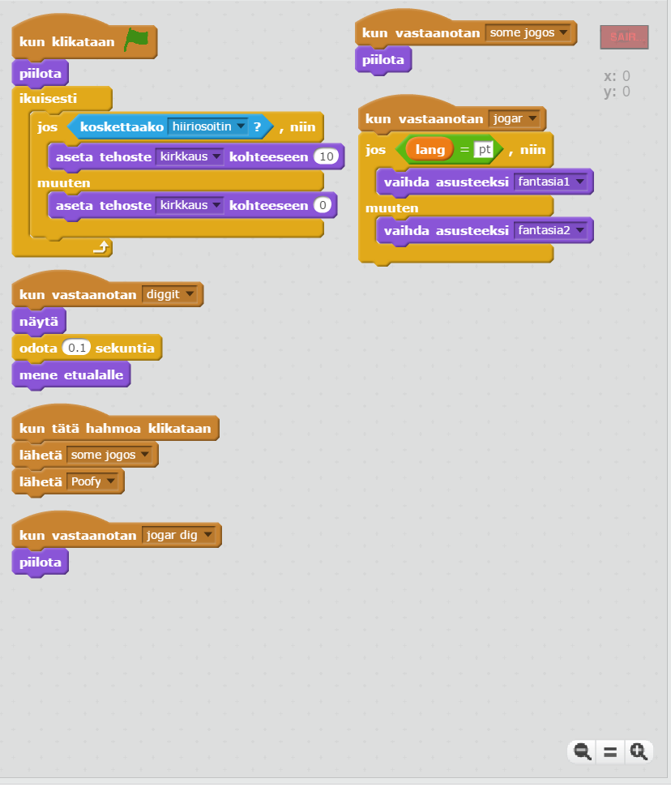

Slide 52
Short Enough
Notes:
Short Enough Full 31.png

Slide 53
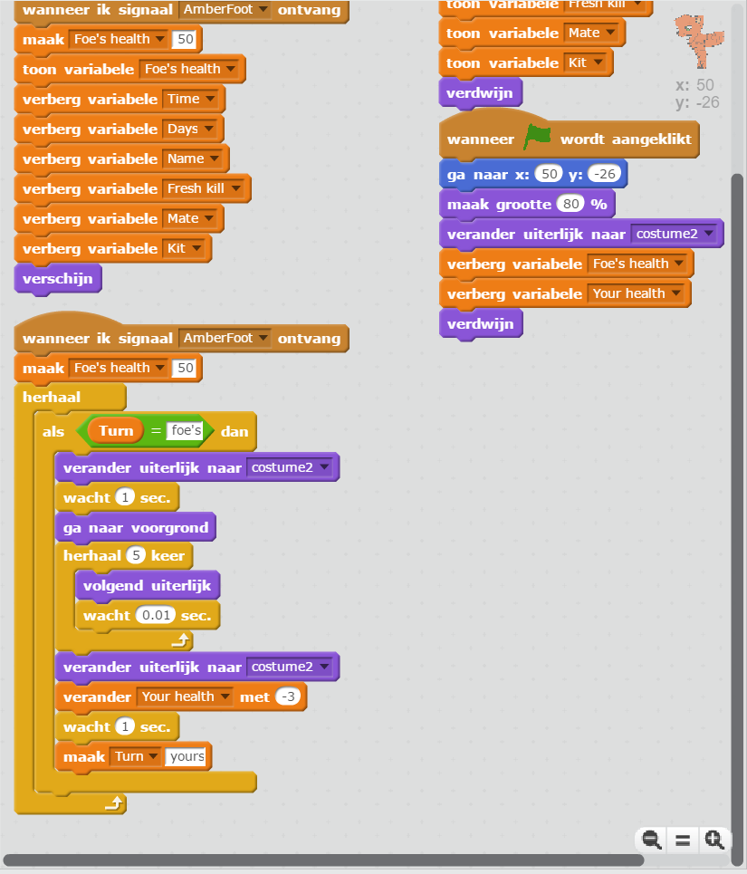

Slide 54
Short Enough
Notes:
Short Enough Full 24.png

Slide 55
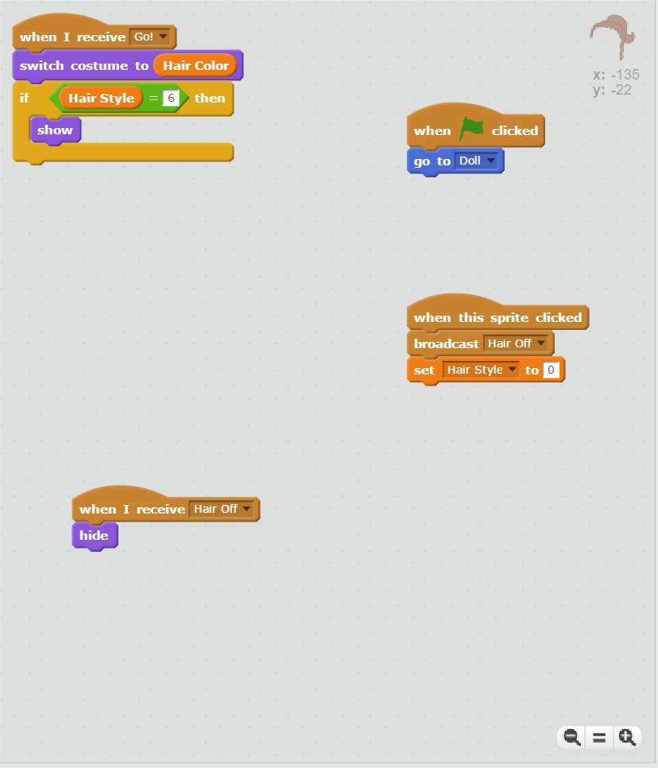

Slide 56
Short Enough
Notes:
Short Enough Full 16.png

Slide 57
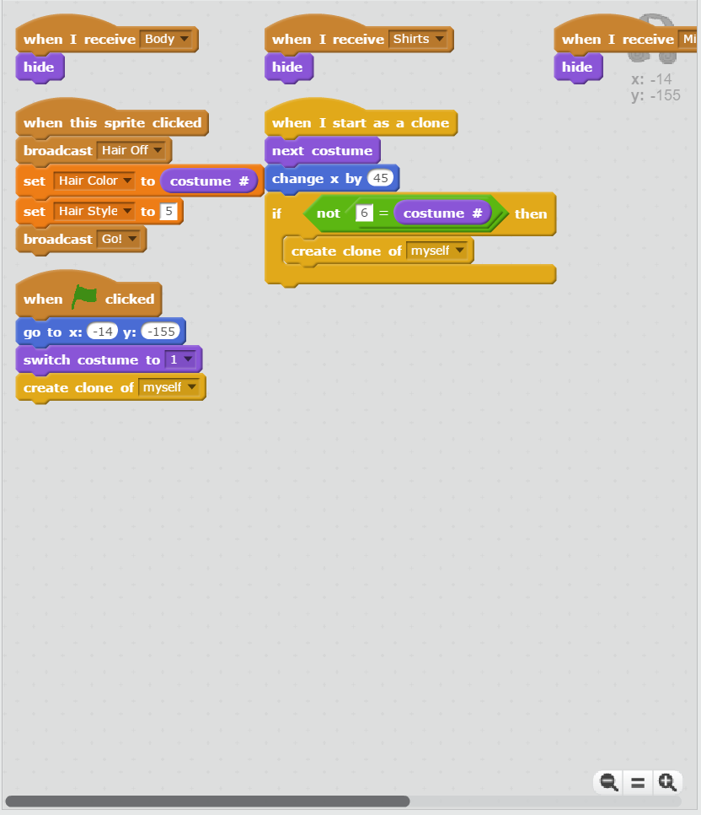

Slide 58
Short Enough
Notes:
Short Enough Full 15.png

Slide 59
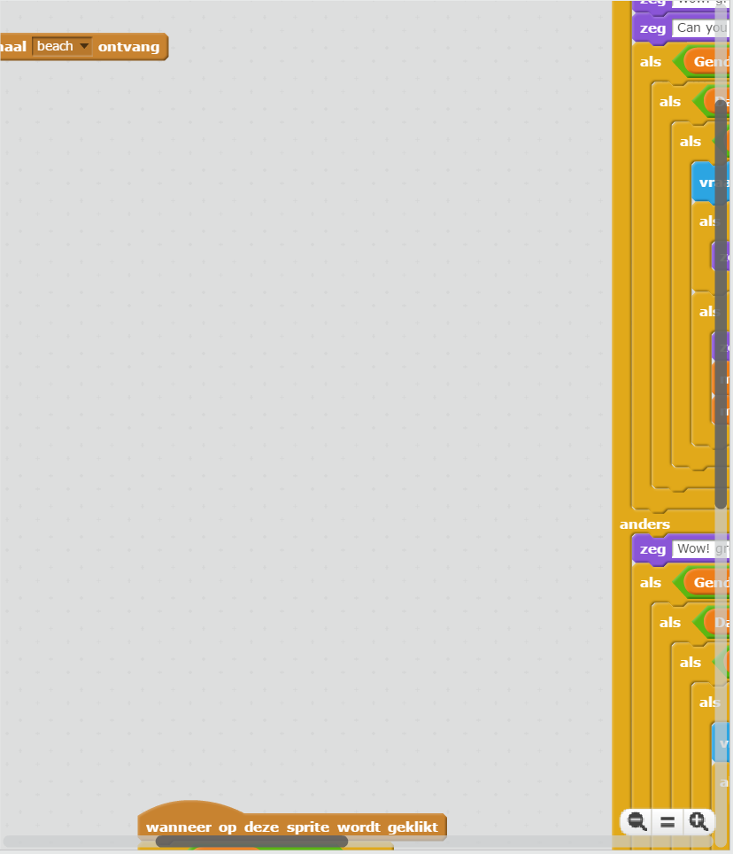

Slide 60
Too Long
Notes:
Too Long Full 34.png

Slide 61
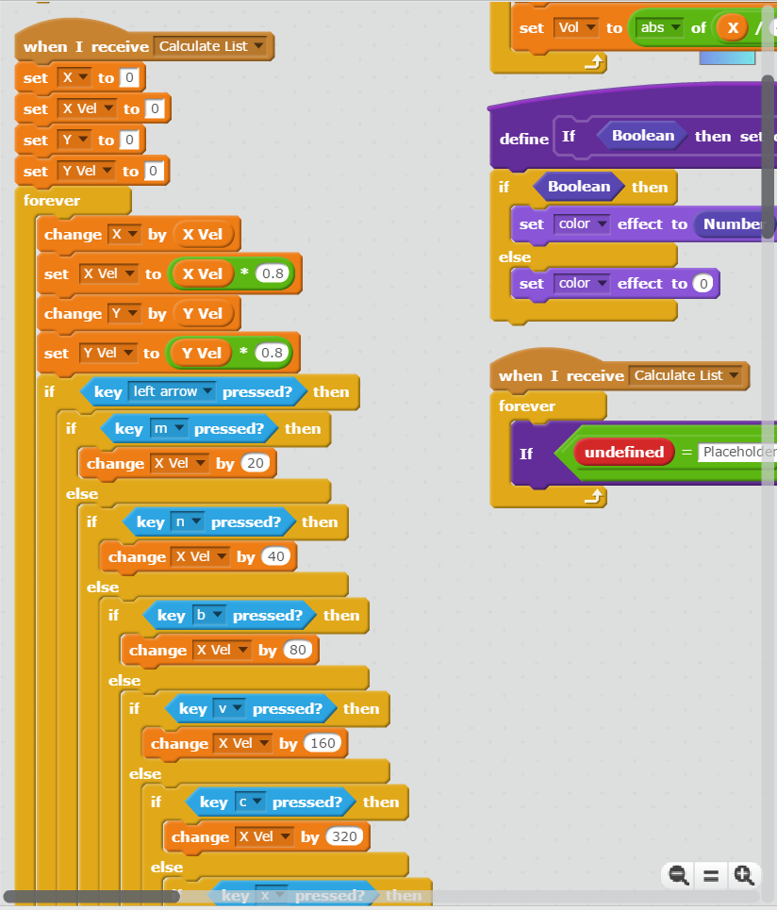

Slide 62
Too Long
Notes:
Too Long Full 02.png

Slide 63
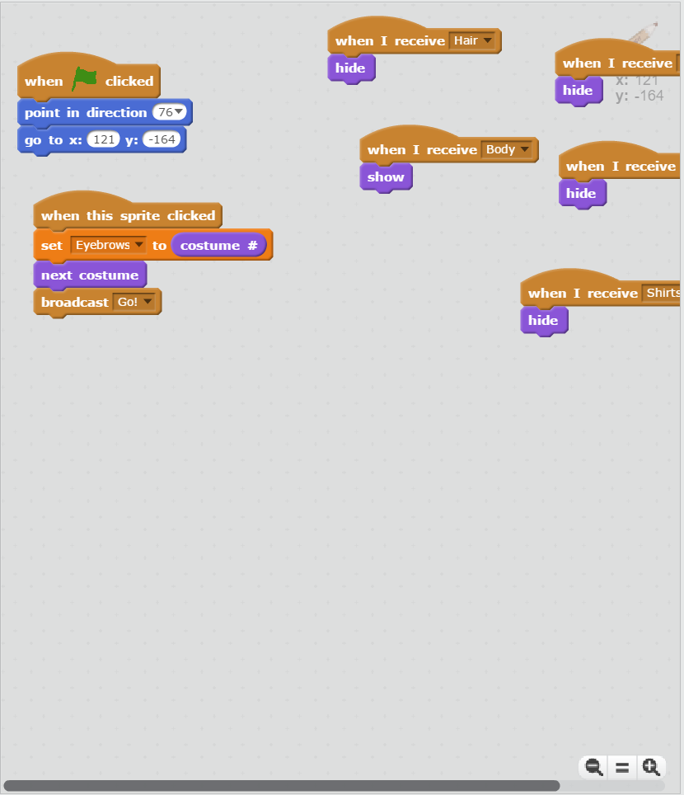

Slide 64
Short Enough
Notes:
Short Enough Full 07.png

Slide 65
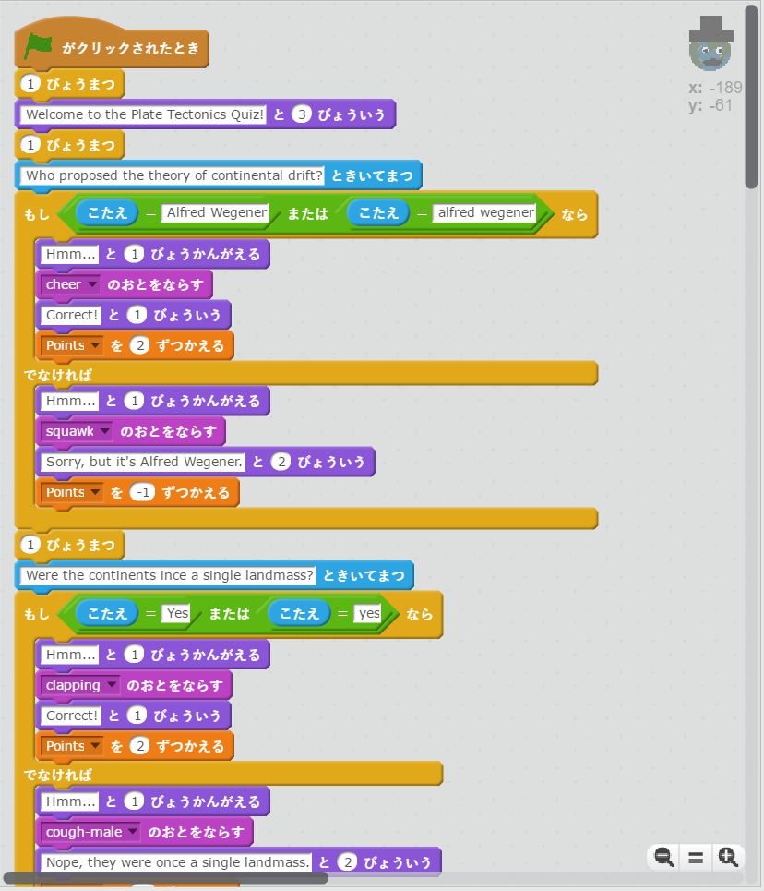

Slide 66
Too Long
Notes:
Too Long Full 30.png

Slide 67
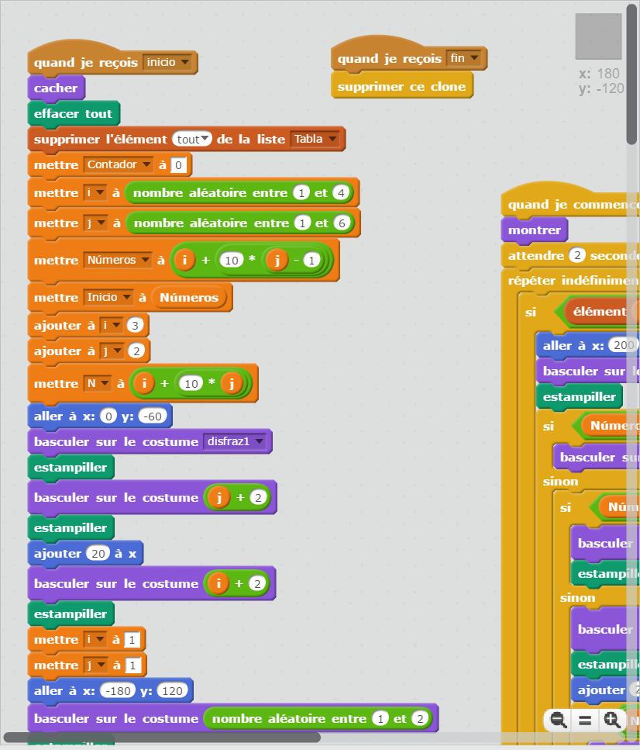

Slide 68
Too Long
Notes:
Too Long Full 22.png

Slide 69
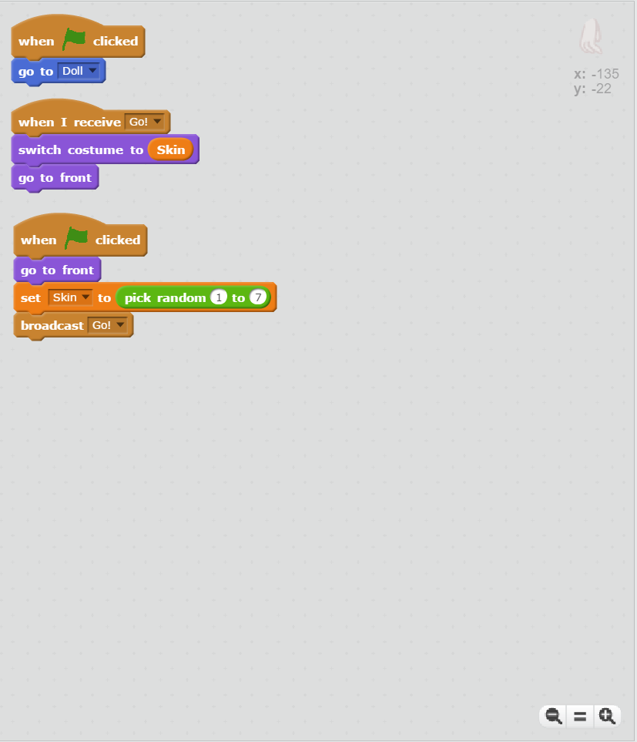

Slide 70
Short Enough
Notes:
Short Enough Full 05.png

Slide 71
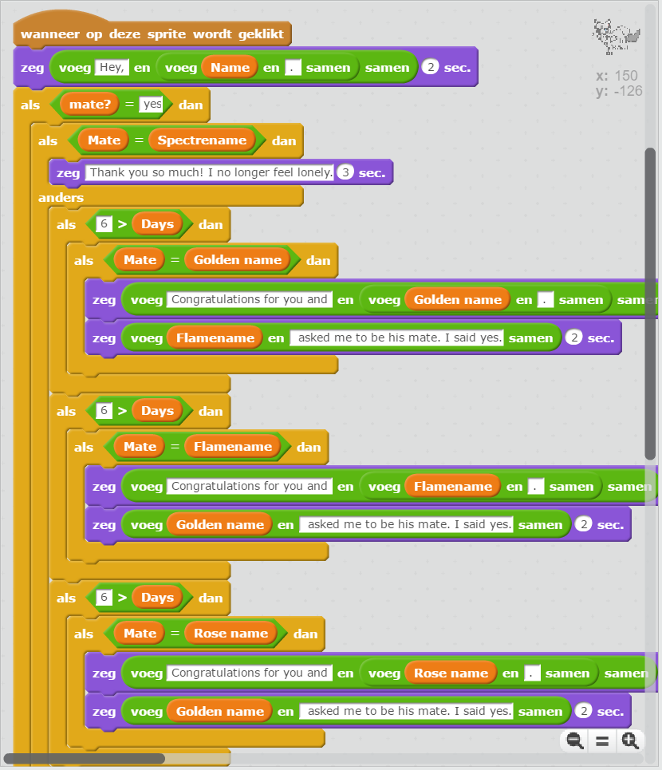

Slide 72
Too Long
Notes:
Too Long Full 24.png

Slide 73
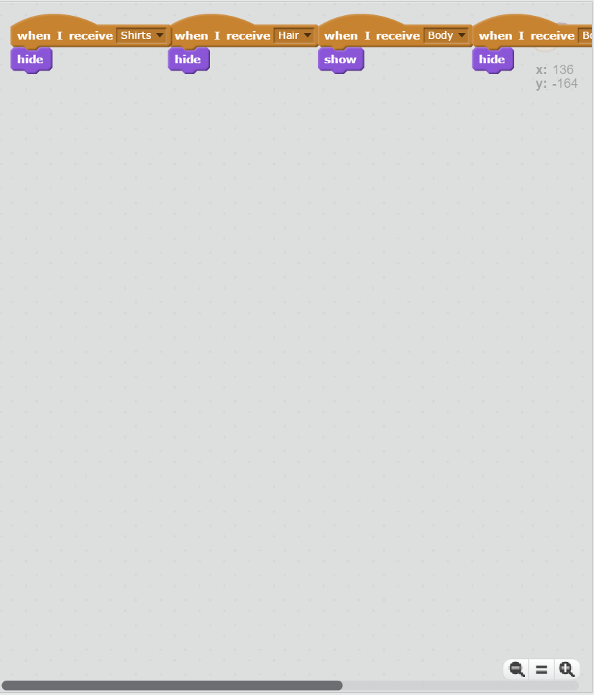

Slide 74
Short Enough
Notes:
Short Enough Full 08.png

Slide 75
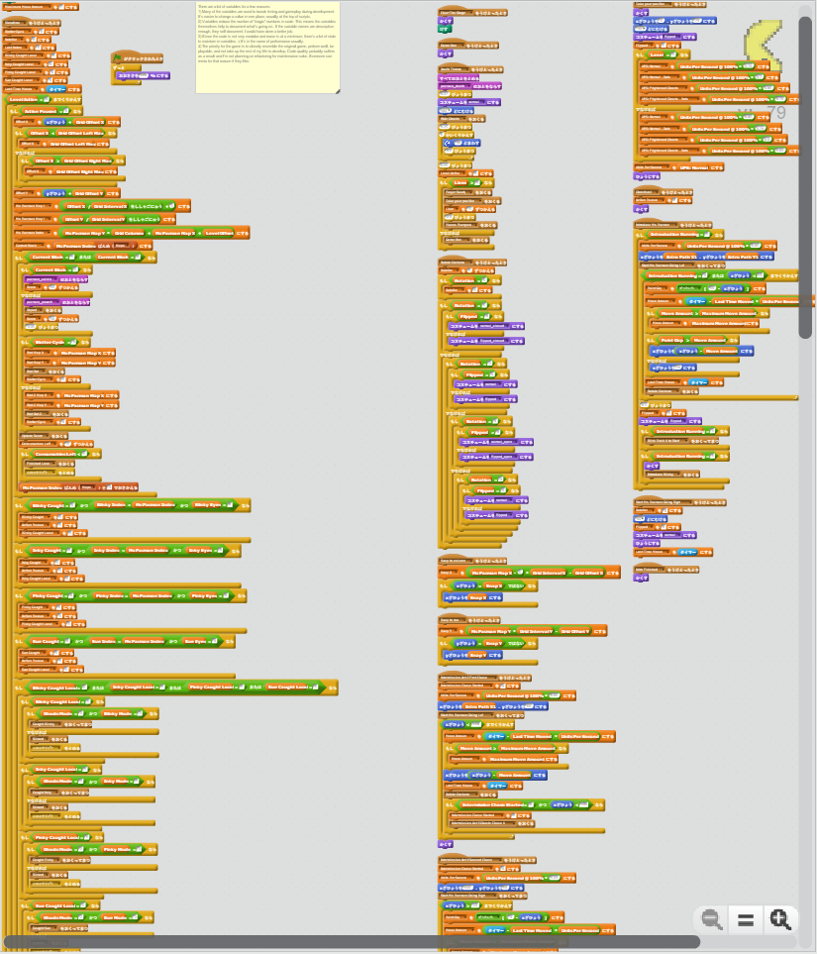

Slide 76
Too Long
Notes:
Too Long Full 32.png

Slide 77
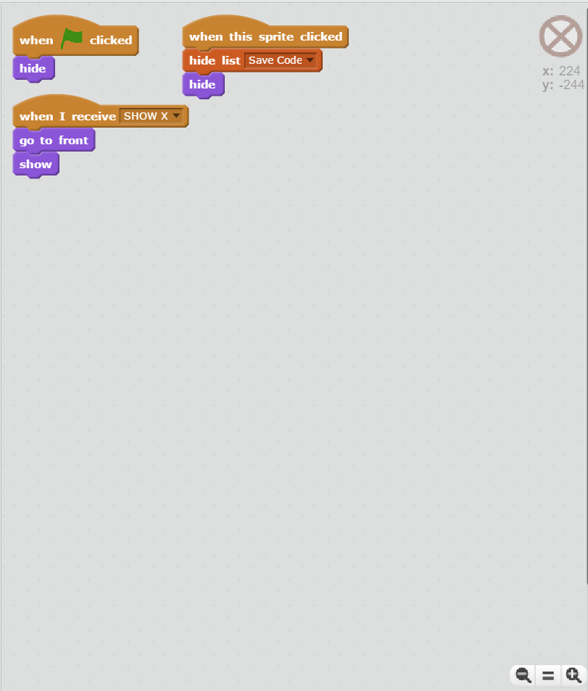

Slide 78
Short Enough
Notes:
Short Enough Full 02.png

Slide 79
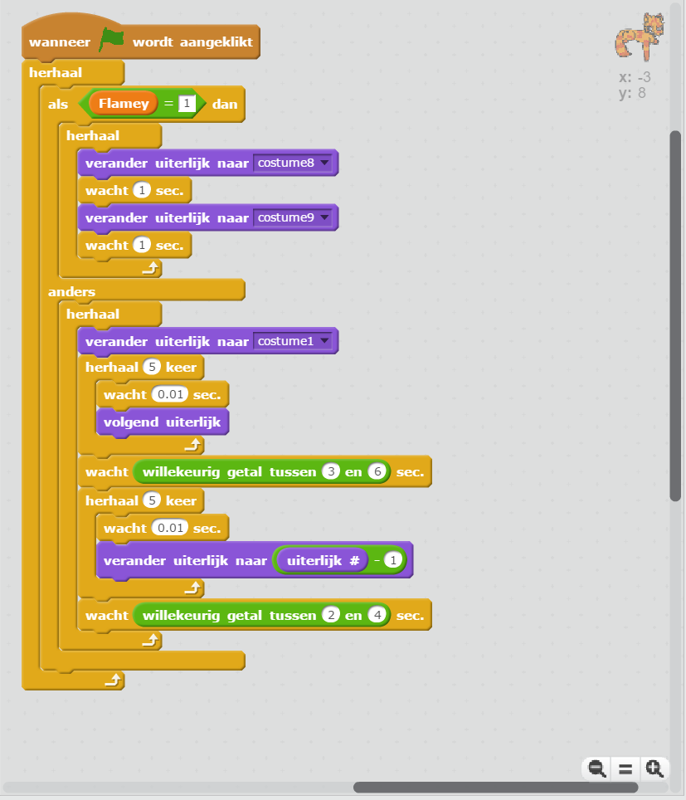

Slide 80
Too Long
Notes:
Too Long Full 16.png

Slide 81
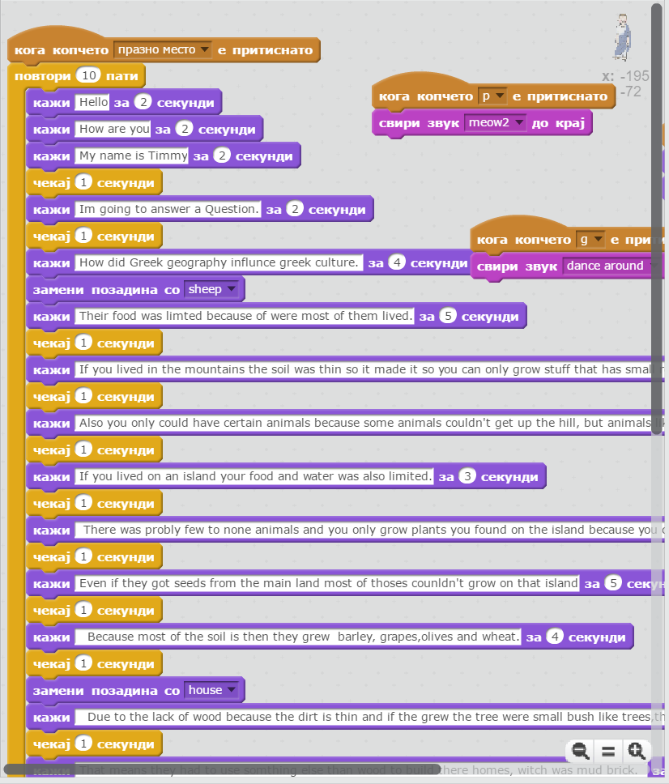

Slide 82
Too Long
Notes:
Too Long Full 23.png

Slide 83
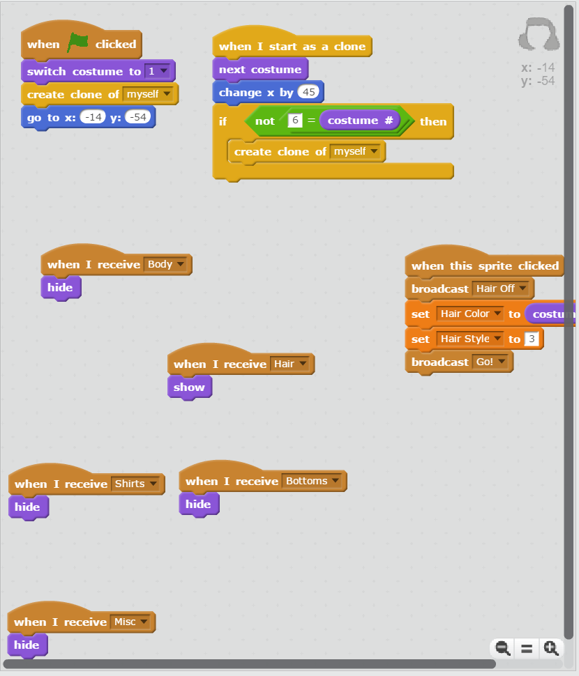

Slide 84
Short Enough
Notes:
Short Enough Full 11.png

Slide 85
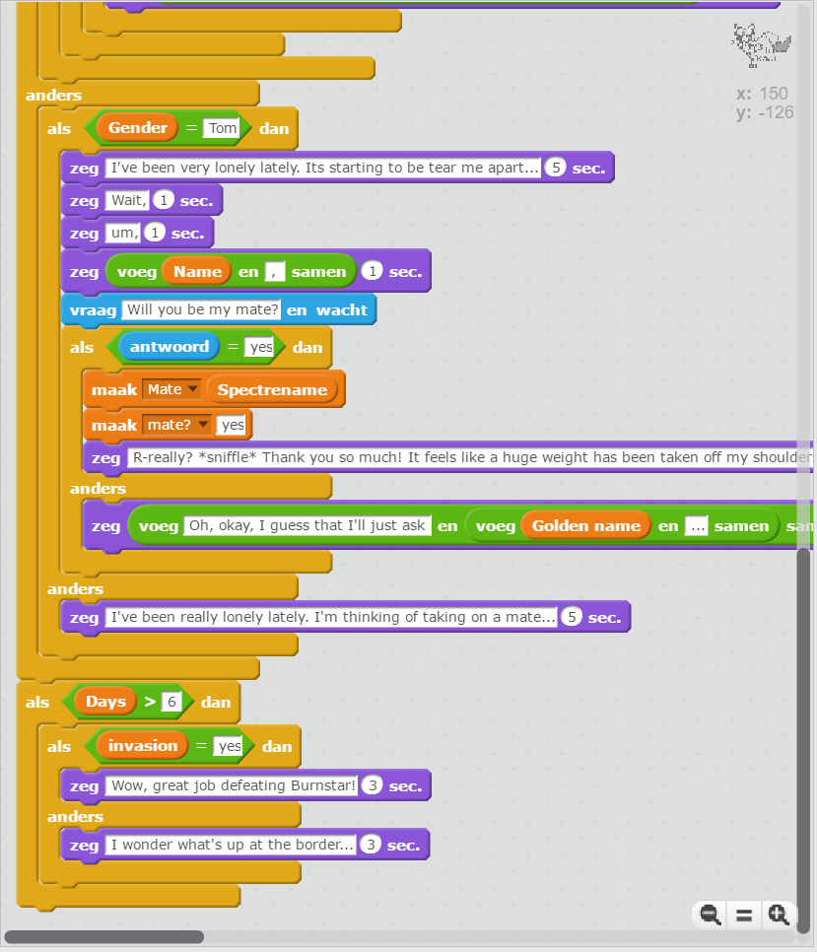

Slide 86
Too Long
Notes:
Too Long Full 13.png

Slide 87
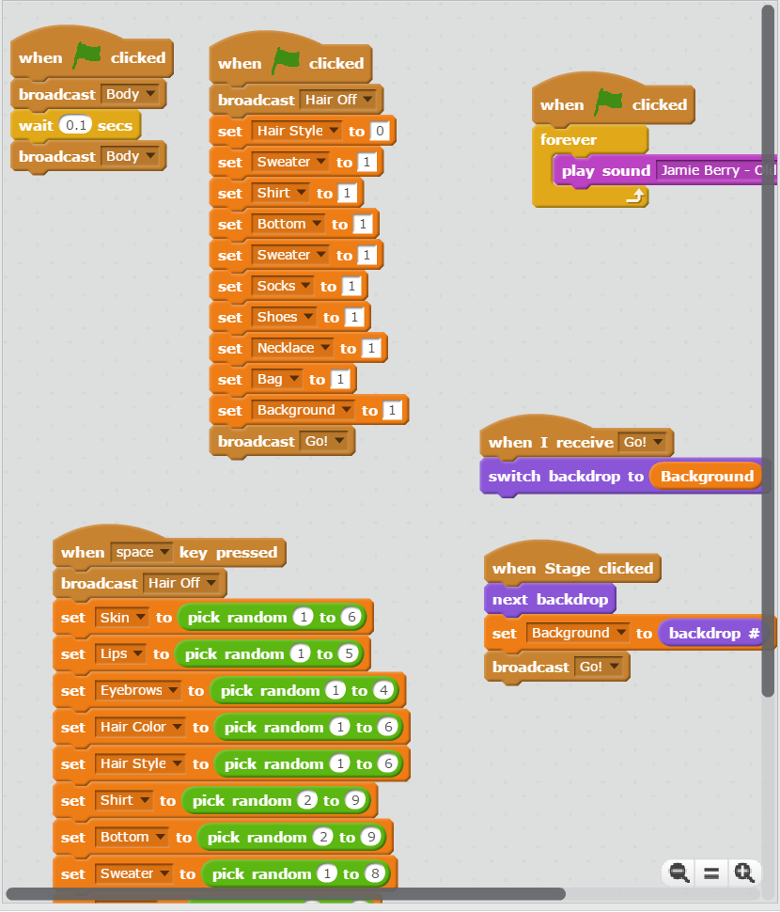

Slide 88
Short Enough
Notes:
Short Enough Full 18.png

Slide 89
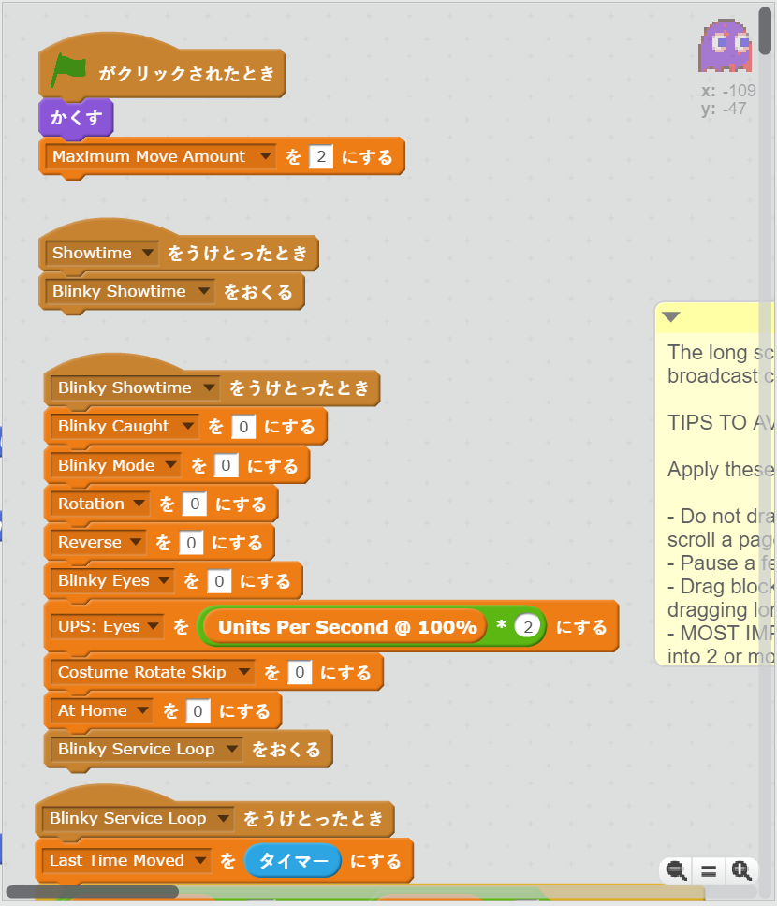

Slide 90
Short Enough
Notes:
Short Enough Full 27.png

Slide 91
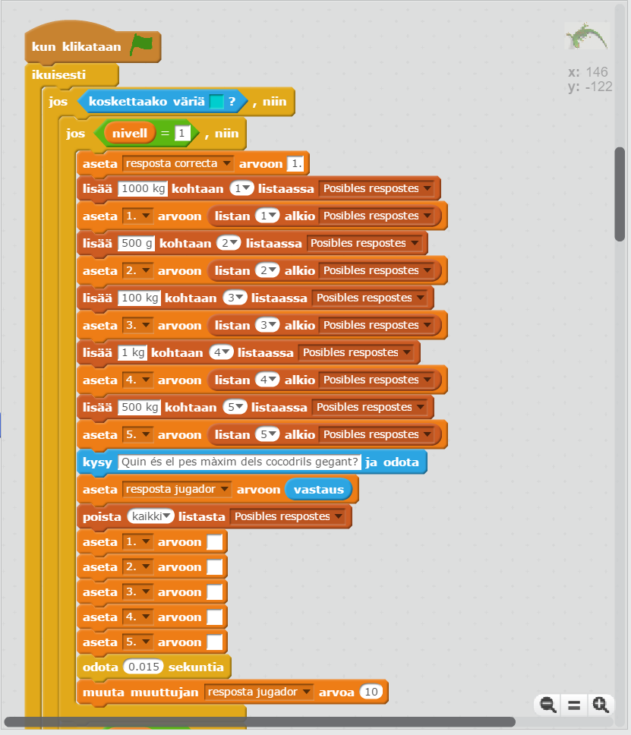

Slide 92
Too Long
Notes:
Too Long Full 25.png

Slide 93
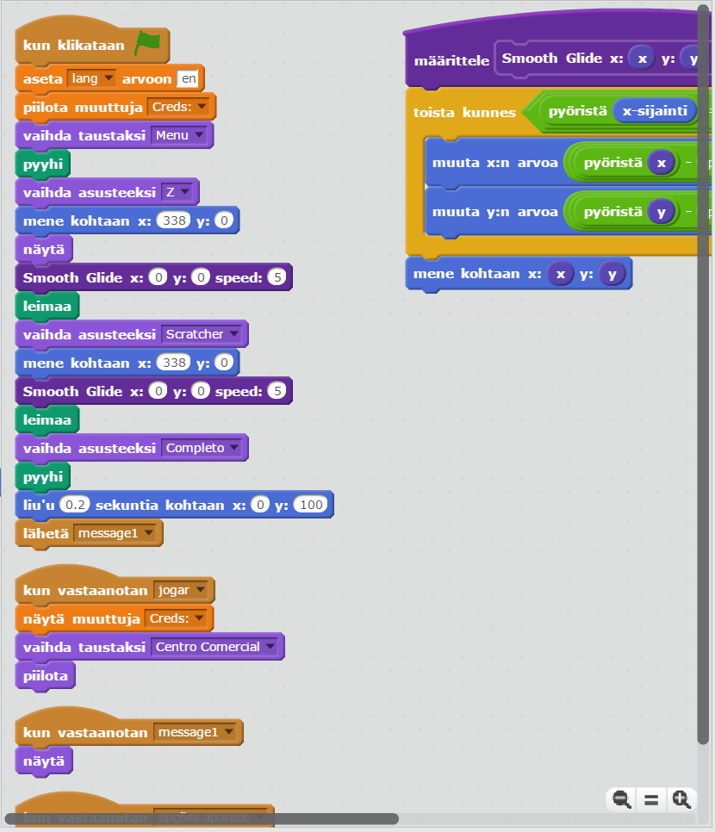

Slide 94
Too Long
Notes:
Too Long Full 26.png

Slide 95
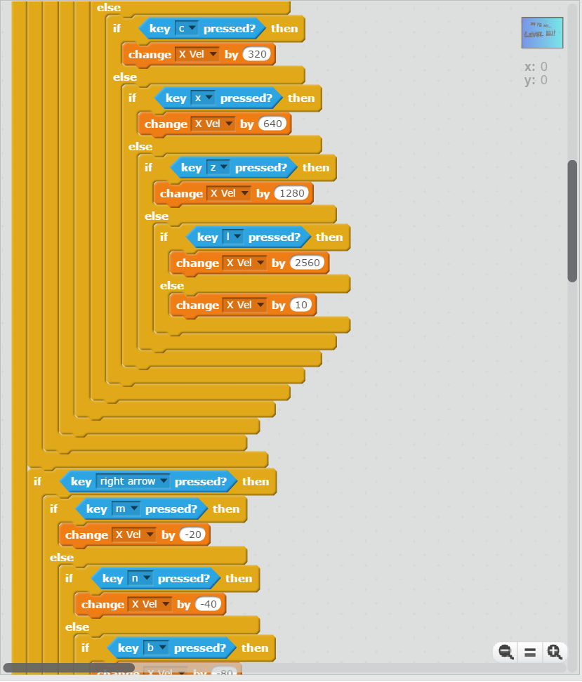

Slide 96
Too Long
Notes:
Too Long Full 04.png

Slide 97
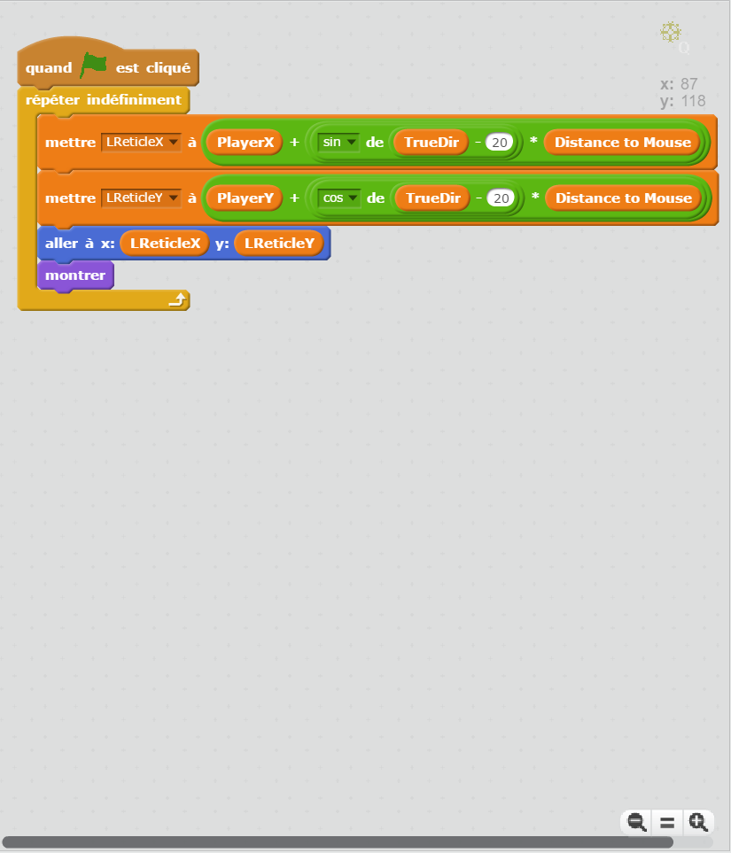

Slide 98
Short Enough
Notes:
Short Enough Full 32.png

Slide 99
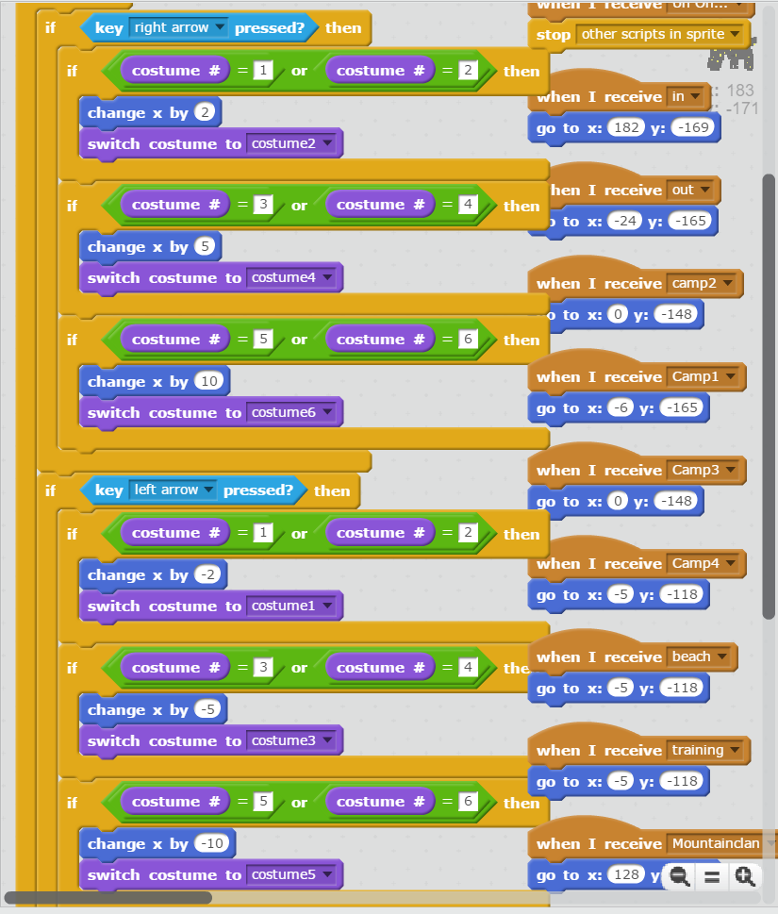

Slide 100
Too Long
Notes:
Too Long Full 06.png

Slide 101


Slide 102
Short Enough
Notes:
Short Enough Full 04.png

Slide 103


Slide 104
Too Long
Notes:
Too Long Full 15.png

Slide 105


Slide 106
Short Enough
Notes:
Short Enough Full 10.png

Slide 107


Slide 108
Too Long
Notes:
Too Long Full 17.png

Slide 109


Slide 110
Too Long
Notes:
Too Long Full 10.png

Slide 111


Slide 112
Short Enough
Notes:
Short Enough Full 34.png

Slide 113


Slide 114
Short Enough
Notes:
Short Enough Full 33.png

Slide 115


Slide 116
Short Enough
Notes:
Short Enough Full 21.png

Slide 117


Slide 118
Too Long
Notes:
Too Long Full 33.png

Slide 119


Slide 120
Too Long
Notes:
Too Long Full 21.png

Slide 121


Slide 122
Short Enough
Notes:
Short Enough Full 06.png

Slide 123


Slide 124
Short Enough
Notes:
Short Enough Full 14.png

Slide 125


Slide 126
Too Long
Notes:
Too Long Full 20.png

Slide 127


Slide 128
Too Long
Notes:
Too Long Full 08.png

Slide 129


Slide 130
Too Long
Notes:
Too Long Full 05.png

Slide 131


Slide 132
Short Enough
Notes:
Short Enough Full 17.png

Slide 133


Slide 134
Short Enough
Notes:
Short Enough Full 03.png

Slide 135


Slide 136
Too Long
Notes:
Too Long Full 11.png

